Slide 1
Lending Club Case Study
Exploring Patterns in Loan Applicants
Group Members
Sravanthi Chundi
Srinivas NV

Slide 2
Introduction
Objective: Analyze factors influencing loan defaults using exploratory data analysis (EDA).
Dataset: It contains the complete loan data for all loans issued through the time period 2007 t0 2011.
Problem Statement:
You work for a consumer finance company which specialises in lending various types of loans to urban customers. When the company receives a loan application, the company has to make a decision for loan approval based on the applicant’s profile. Two types of risks are associated with the bank’s decision:
If the applicant is likely to repay the loan, then not approving the loan results in a loss of business to the company
If the applicant is not likely to repay the loan, i.e. he/she is likely to default, then approving the loan may lead to a financial loss for the company
The data given below contains information about past loan applicants and whether they ‘defaulted’ or not. The aim is to identify patterns which indicate if a person is likely to default, which may be used for taking actions such as denying the loan, reducing the amount of loan, lending (to risky applicants) at a higher interest rate, etc.

Slide 3
Approach
EDA
Visualization
Insight Generation
Data Cleaning
Load the data into a data frame.
Drop the columns with null values, single unique value, More than 30% missing values
Standardise the data into correct data type.
Generate multiple graphs based on the data
Generate correlation heat maps
Analyse the Graphs and genenrate the insights
Create derived matrix for year and month
Univariate Analysis
Bivariate Analysis
Multivariate Analysis

Slide 4
Data Understanding
Key Variables:
annual_inc : The self-reported annual income provided by the borrower during registration.
emp_length : Employment length in years. Possible values are between 0 and 10 where 0 means less than one year and 10 means ten or more years.
loan_amnt : The listed amount of the loan applied for by the borrower. If at some point in time, the credit department reduces the loan amount, then it will be reflected in this value.
loan_status : Current status of the loan
Grade : LC assigned loan grade
home_ownership : The home ownership status provided by the borrower during registration. Our values are: RENT, OWN, MORTGAGE, OTHER.
verification_status : Indicates if income was verified by LC, not verified, or if the income source was verified

Slide 5
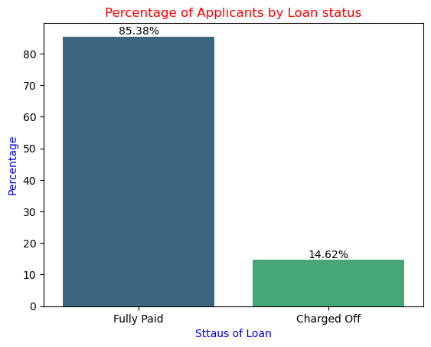
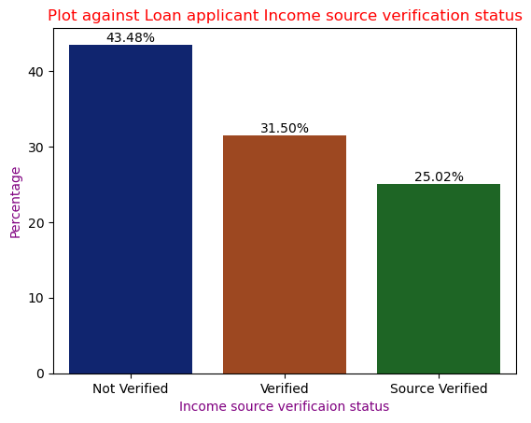
Distribution of overall Applicants by Loan status and Income verified status
85% of loan applicants paid the loan fully
Nearly 15% of loan applicants are defaulted, and could not paid the
loan
Plot shows, most of loan applicants income source is Not verified, it creates a risk

Slide 6
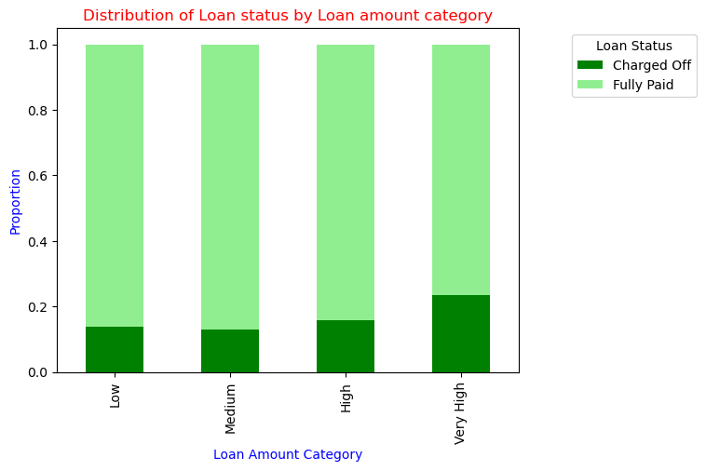
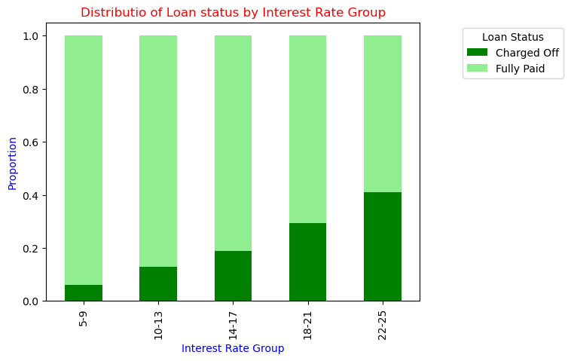
Loan Status Vs Loan Amount Category
Plot shows, for Very High Loan Amounts the Charged Off are more.
Plot shows - As interest increases, the proportion of Charged Off loans increased and at the same time the proportion of Fully Paid loans decreased
Higher Interest Rate groups 18-21% and 22-25% , loan applicants for Charged Off loans increased. It shows higher Interest rate is a cause for "Defaults"

Slide 7
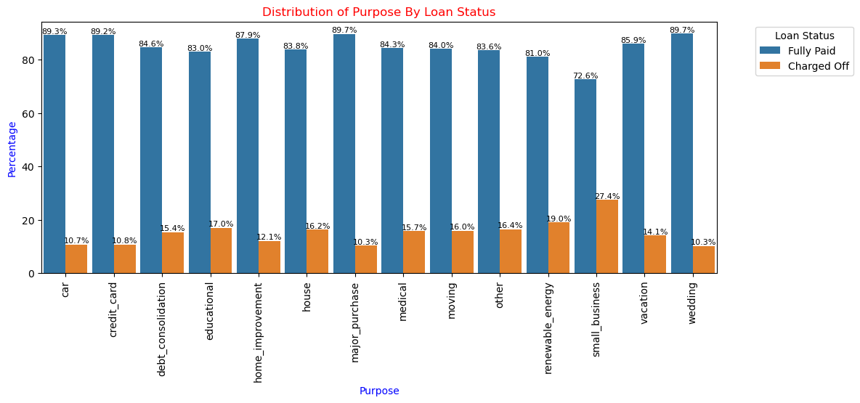
Loan Purpose by Loan Status
Bar graphs denotes that loans taken for small business, educational have more chances of defaulters

Slide 8
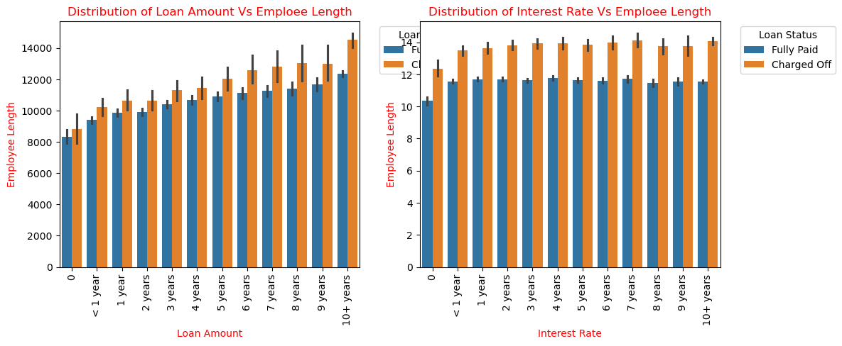
Loan Amount Vs Emp Length and Interest Rate
Employee Length and Loan Amount: Applicants with longer employment length have higher loan amounts, then the less employment length.
Employee Length and Interest Rates: Applicants with shorter employment lengths are having higher interest rates, and "Charged Off" loans generally have higher interest rates than "Fully Paid" loans.

Slide 9
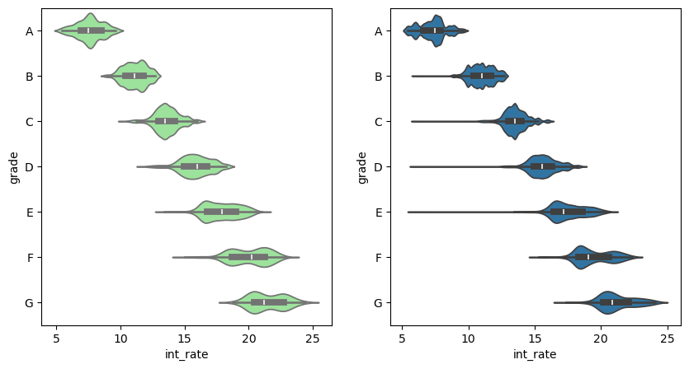
Interest Rate Vs Grade
The interest rates are increasing with each grade.
Low grades/ Low Creditworthiness (F and G) are associated with higher interest rates.
It seems Interest rates are higher for low grades. Lenders charging higher interest rates for risk loans.

Slide 10
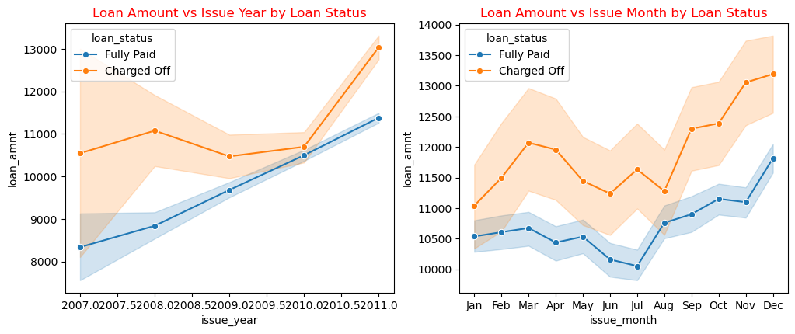
Loan Amount Vs Issue Year By Loan Status and Loan Amount Vs Issue Month By Loan Status
Loan Amount vs Issue Year
Loan Amounts for Charged Off are usually higher when compared to Fully Paid across all the Years
For Fully Paid loans the loan amount has increased consistently over years and observed peak in 2011
For Charged Off loans, we can see it increased and deacreased till 2010 and observed a sudden peak in 2011
Loan Amount vs Issue Month
Loan Amounts for Charged Off are usually higher when compared to Fully Paid across all Months
For "Fully Paid" loans show less variability till for first few months and increased in later months of the year.
For Charged Off loans show high variability and increased in later months of the year.

Slide 11
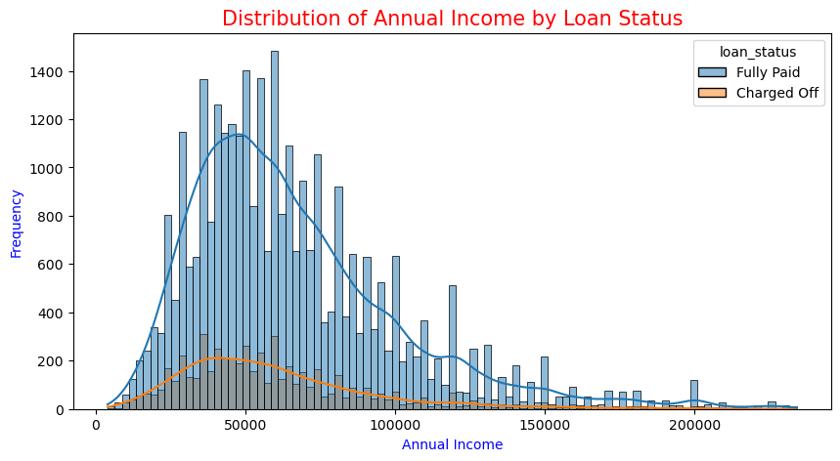
Annual Income Vs Loan Status
Distribution of Annual Income is rightly skewed for both Fully paid and Charged off loan status.
Its indicating most of the loan applicants havig low to moderate income and very few have high income
Most Applicatons with lower income have Charged Off loans. Most of Higher annual income applicants are "Fully paid".

Slide 12
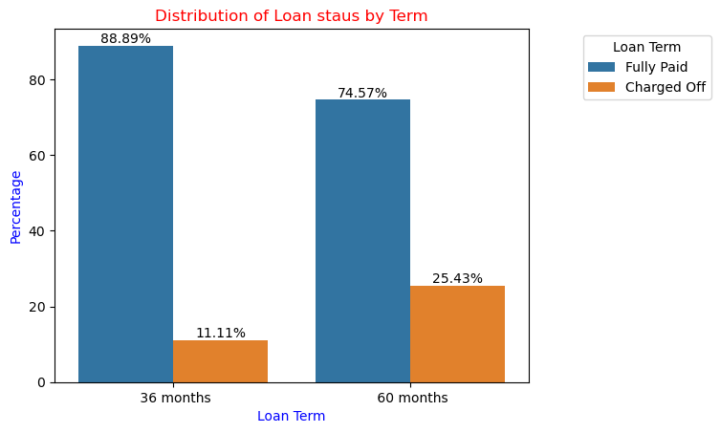
Distribution of Loan staus by Term
Plot shows, The number of Defaults for Charged of loan are higher in 60 months loan term than 36 months
Fully paid, term 36 months loan apploicants are paying loan more than 60 months term

Slide 13
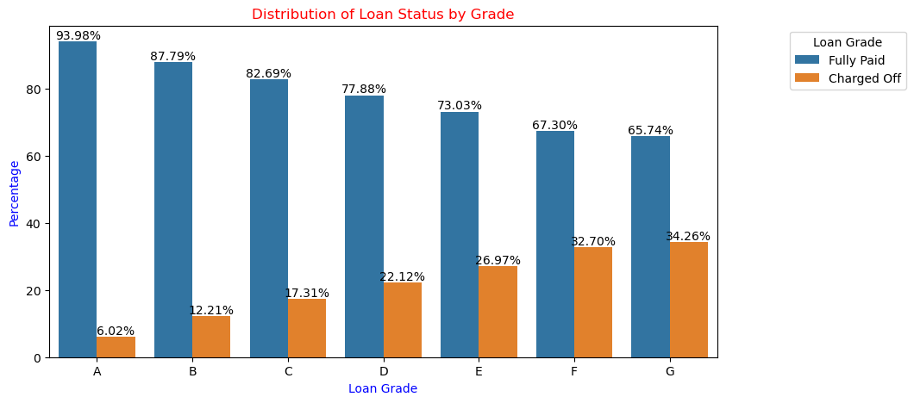
Distribution of Loan status by Term
Plot shows, The number of Defaults for Charged of loan are higher in 60 months loan term than 36 months
Fully paid, term 36 months loan apploicants are paying loan more than 60 months term

Slide 14
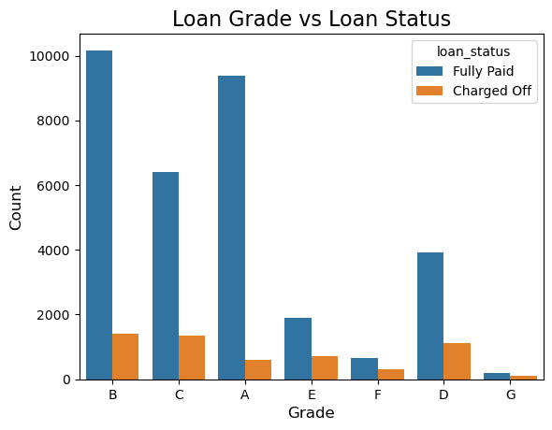
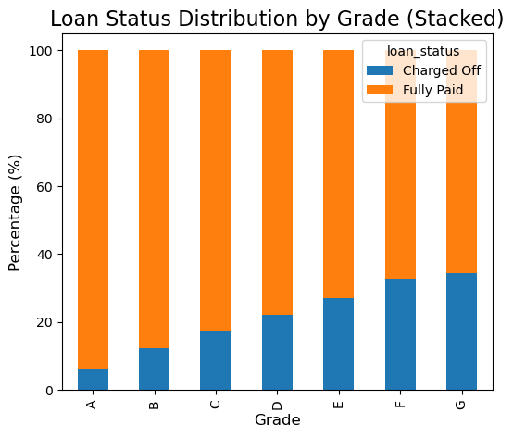
Grade Vs Loan Status
Plot shows that Applicants with Grade A,B,C his high chances of Fully paid. In other words, lower the grades higher the risk of defaulters.

Slide 15
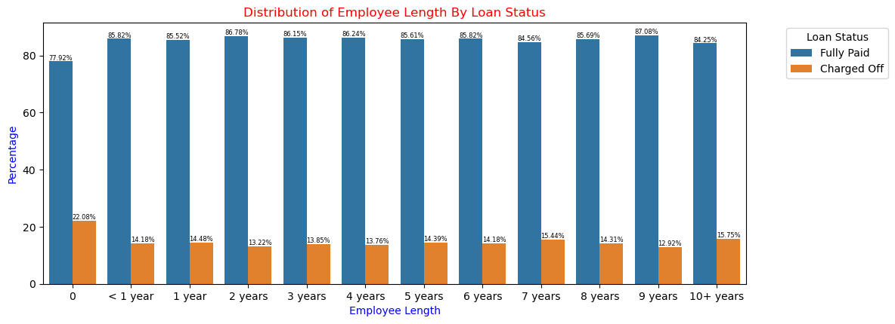
Employee Length By Loan Status
Graph denotes that Employees with More than 10 years of experience has high chances of getting verified over others with less experience

Slide 16
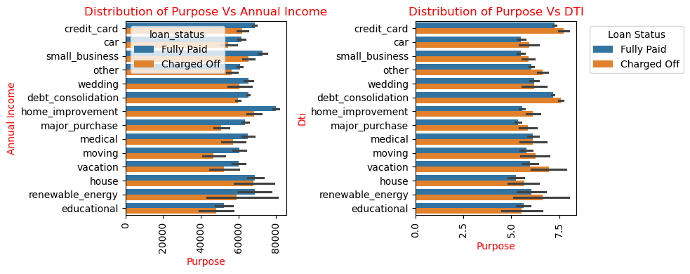
Annual Income Vs Purpose and DTI Vs Purpose
Interest Rate vs. Purpose: Interest rates for "Charged Off" loans are high when compared to "Fully Paid" For House and Small Business the rates are exceptionally high for "Charged Off" loans.
Loan Amount vs. Purpose: Loan amounts tend to be higher for loans that were "Charged Off" compared to "Fully Paid"
Annual Income vs. Purpose: Annual income levels tend to be higher for "Fully Paid" loans compared to "Charged Off" loans for most purposes.
DTI vs. Purpose: DTI ratios for "Charged Off" loans are generally higher compared to "Fully Paid" loans across most loan purposes.
Summary: Higher interest rates, larger loan amounts for purposes like "small_business" and "home_improvement", higher DTI ratios are more likely to be charged off.

Slide 17
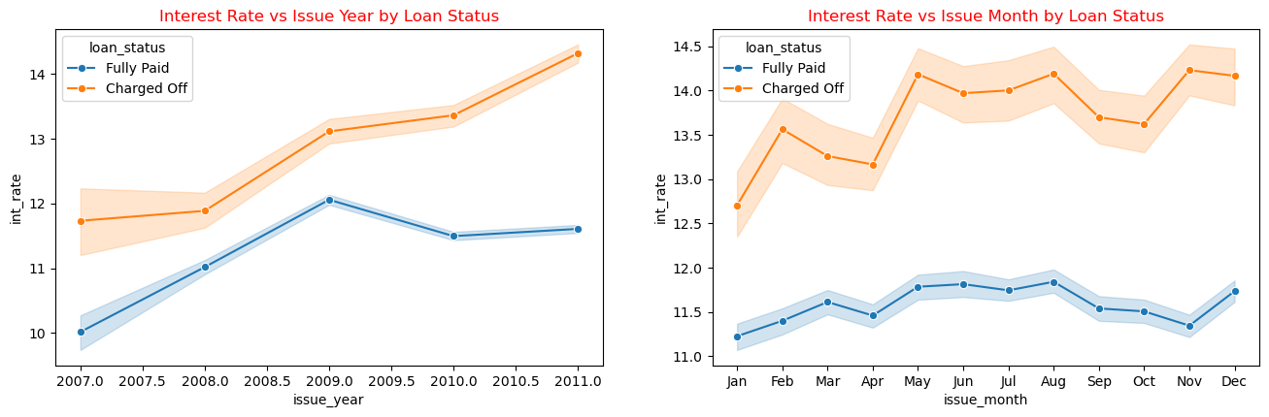
Interest Rate Vs Issue Year and Interest Rate Vs Issue Month By Loan Status
Interest Rate vs Issue Year
Interest rates for "Charged Off" loans increase significantly over the years, peaking around 2011.
Interest rates for "Fully Paid" loans also increase over the years but at a slower rate
Interest Rate vs Issue Month
Interest rates for "Charged Off" loans are generally higher across all months, with noticeable peaks in May, Aug and November.
Interest rates for "Fully Paid" loans show less variability and generally lower values across the months

Slide 18
Key Findings
Interest rate is a strong predictor of loan default risk. Higher interest rates are associated with significantly increased charge-off rates.
Applicants income is a critical factor to do Loan payment. Lower-income individuals exhibit higher default rates.
Loan grade is a significant determinant of loan risk. Lower-grade loans (D, E, F, G) have a substantially higher defaults compared to higher-grade loans (A, B).
Debt-to-income (DTI) ratio is positively correlated with loan default risk. Higher DTI ratios indicate increased chances of charge-off.
Bankruptcy history is a strong indicator of elevated loan default risk.

Slide 19
Observations
Loan Applicants with shorter employment lengths having higher interest rates are more likely to default on their loans.
Economic conditions can influence loan performance. In year 2011, we saw an increase in both loan volume and default rates
Loan purpose impacts loan performance. Loans for small businesses tend to have higher interest rates and default rates.
Loan grade is a strong indicator of loan performance. Higher-grade loans have lower default rates.
Income level is associated with loan performance. Lower-income Applicants have a higher default compared to higher-income borrowers.
Bankruptcy history is likely correlated with loan default, as indicated by the relationship between grade and charge-off rates

